Slide 1
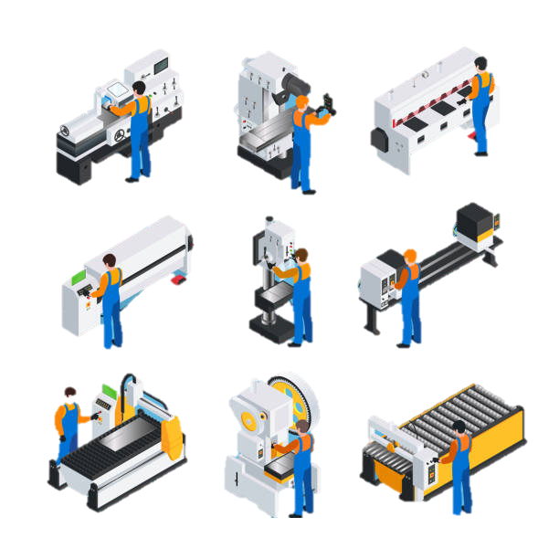

PREDICTIVE MAINTENANCE FOR MACHINERY
TOOLS & TECHNOLOGY USED:
Supervised Machine Learning Technique, Python.
Presented by:
Juhi Moudekar
© All rights reserved by Fireblaze Technologies Pvt. Ltd.

Slide 2
PROBLEM STATEMENT
THE PROBLEM:
Traditional maintenance approaches are inefficient: reactive maintenance (fix-after-failure) causes unplanned downtime and production loss, while scheduled maintenance often services healthy machines unnecessarily or misses faster-than-expected wear.
Modern machines generate continuous sensor data (temperature, speed, torque, tool wear); an opportunity to predict failures before they happen instead of guessing on a fixed schedule.
Core question this project answers: Can we use machine sensor readings to
(1) predict whether a machine is about to fail, and
(2) if so, identify what type of failure is occurring?
Key challenge: Failures are rare. Only ~3.4% of machines in the dataset actually fail, making this a class-imbalance problem where a "lazy" model could look 96%+ accurate while being completely useless.
© All rights reserved by Fireblaze Technologies Pvt. Ltd.

Slide 3
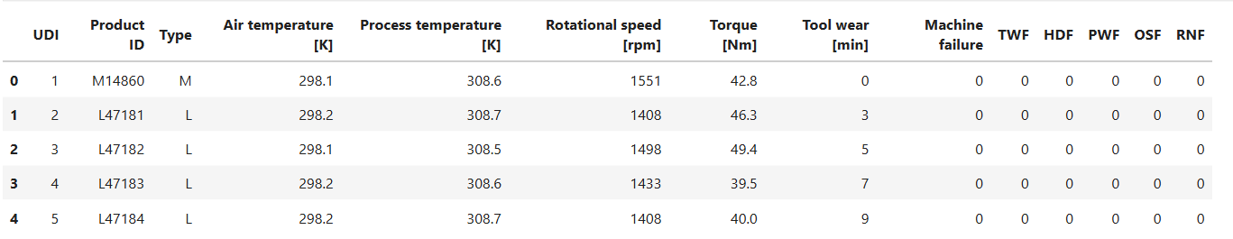
ABOUT THE DATA
1. Dataset: AI4I 2020 Predictive Maintenance Dataset 2. Source: UCI Machine Learning Repository 3. URL: https://archive.ics.uci.edu/dataset/601/ai4i+2020+predictive+maintenance+dataset 4. Description: A synthetic dataset (10,000 records, 14 features) modelled on real industrial milling machine operations, including sensor readings such as air temperature, process temperature, rotational speed, torque, and tool wear, along with binary failure labels and five specific failure-type flags (TWF, HDF, PWF, OSF, RNF).
© All rights reserved by Fireblaze Technologies Pvt. Ltd.

Slide 4
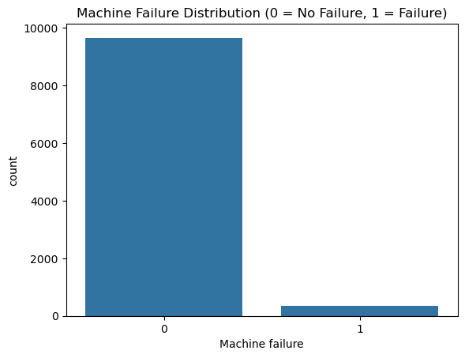
CLASS IMBALANCE
Severe Class Imbalance in the Target Variable
Only ~339 of 10,000 machines (3.4%) failed, making this a severely imbalanced classification problem
A model that always predicts "no failure" would still score ~97% accuracy — proving that accuracy alone is the wrong metric here
© All rights reserved by Fireblaze Technologies Pvt. Ltd.

Slide 5
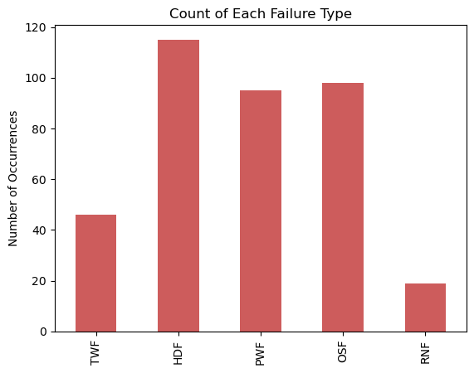
FAILURE TYPE BREAKDOWN
Heat Dissipation is the Most Common Failure Mode
Heat Dissipation (HDF) is the most common failure mode (~115 cases), followed by Overstrain (OSF) and Power Failure (PWF)
Random Failure (RNF) is the rarest (~19 cases) by design — it has no detectable sensor pattern, representing real-world unpredictability
© All rights reserved by Fireblaze Technologies Pvt. Ltd.

Slide 6
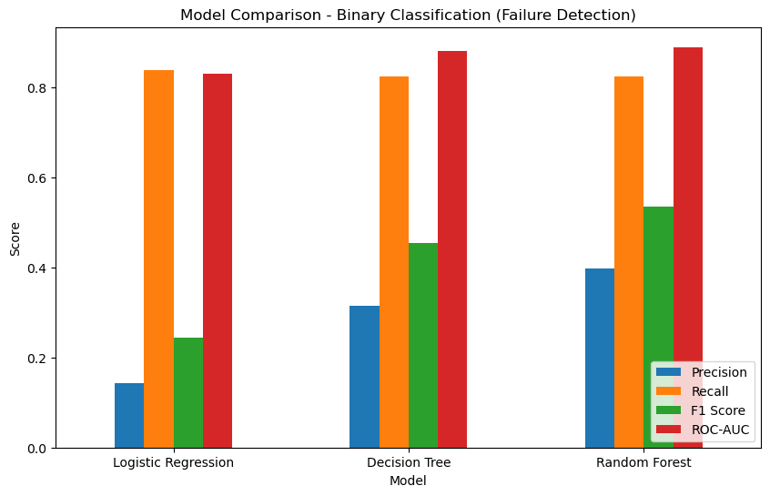
MODEL COMPARISON
Random Forest Delivers the Best Overall Balance
Random Forest achieves the highest Precision, F1 Score, and ROC-AUC, while matching the other models on Recall
Logistic Regression's high Recall is misleading on its own — its much lower Precision means more false alarms for the same failures caught
© All rights reserved by Fireblaze Technologies Pvt. Ltd.

Slide 7
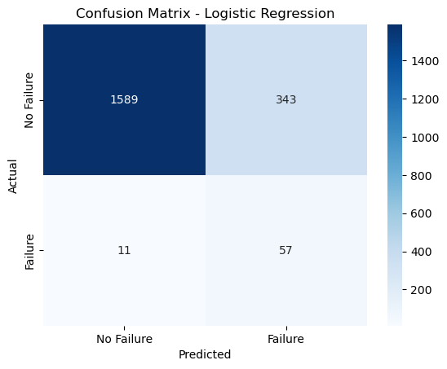
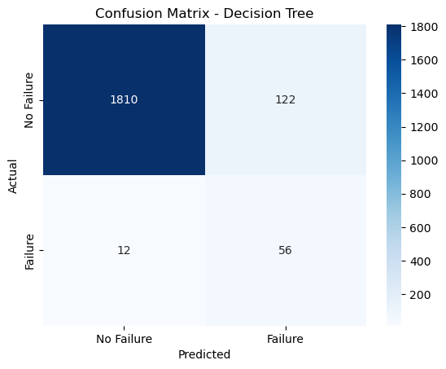
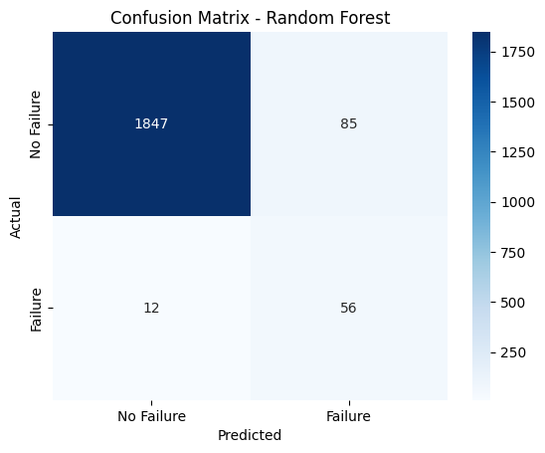
CONFUSION MATRIX
Confusion Matrix Comparison
Random Forest correctly caught 56 of 68 actual failures, missing only 12 — a Recall of ~82%
It accepted 85 false alarms in exchange, a reasonable tradeoff since missed failures are costlier than unnecessary inspections
© All rights reserved by Fireblaze Technologies Pvt. Ltd.

Slide 8
PROPOSED SOLUTION
A two-stage supervised ML pipeline, mirroring how predictive maintenance would actually be deployed:
Stage 1: Failure Detection (Binary Classification): Predicts whether a machine will fail, using Logistic Regression, Decision Tree, and Random Forest, compared head-to-head.
Stage 2: Failure Diagnosis (Multiclass Classification): For machines flagged as failing, a Random Forest model identifies the most likely failure type.
Handling the imbalance: SMOTE (Synthetic Minority Oversampling) applied only to training data, never to test data, to avoid data leakage.
Evaluation metrics: Precision, Recall, F1-score, ROC-AUC — not plain accuracy, since accuracy is misleading on this dataset.
Why Recall matters most here: missing a real failure (false negative) is far costlier than a false alarm (false positive) in a maintenance context.
Final model chosen: Random Forest — best balance of Recall and F1 across the test results.
© All rights reserved by Fireblaze Technologies Pvt. Ltd.

Slide 9
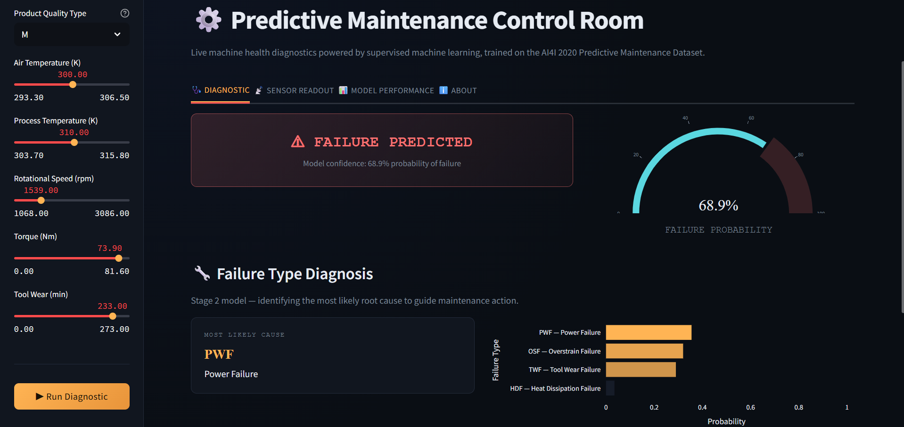

Slide 10
CONCLUSION
Shifts maintenance from reactive/fixed-schedule to predictive — flagging at-risk machines before they fail, not after
Caught ~82% of real failures before occurrence (Recall ≈ 0.82) — most breakdowns no longer need to be a surprise
Reduces unnecessary servicing by targeting only flagged machines instead of every machine on a fixed schedule
Failure-type prediction lets technicians arrive with the right part in hand, cutting repair time
Trade-off accepted by design: some false alarms (85) vs. missed failures (12) — the right call, since a missed failure costs far more than an unnecessary inspection
Bottom line: Converts unpredictable, costly breakdowns into manageable, scheduled interventions — the core value proposition of predictive maintenance
© All rights reserved by Fireblaze Technologies Pvt. Ltd.

Slide 11
FUTURE SCOPE
Live/Streaming Data — Connect to real sensor feeds via API instead of manual input, allowing predictions to update automatically in real time
Stronger ML Models — Test XGBoost and LightGBM, known to outperform Random Forest on tabular data, for potentially better precision-recall tradeoffs
Historical Trend Dashboard — Add a tab visualizing a machine's failure-risk trend over time using logged predictions, enabling earlier warning signals
Automated Alerting System — Trigger email/notification alerts when predicted failure probability crosses a critical threshold
Multi-Machine Monitoring View — Extend from single-machine input to a dashboard tracking multiple machines, sorted by risk level
© All rights reserved by Fireblaze Technologies Pvt. Ltd.

Slide 12
THANK YOU.

